Slide 1
JavaScript for Web Warriors, 7e Chapter 4: Debugging and Error Handling

Slide 2
Chapter Objectives
By the end of this chapter, you should be able to:
Understand four different types of errors that programmers must deal with.
Use the debugger console to locate errors in a program.
Use JavaScript in strict mode.
Trace an error to its source.
Notes:
Instructions: Briefly review with students the major concepts you will be covering during this class. There is one objective for every major A-head section of the chapter.

Slide 3
Introduction to Debugging (1 of 6)
To write a program in JavaScript, you must understand:
JavaScript's syntax (rules)
Computer-programming logic (how to arrange operations to achieve a program's intended goal)
Bug: any error in a program's syntax or logic that causes it to function incorrectly
Debugging: the act of tracing and resolving errors in a program
Load-time errors
Load-time errors (a.k.a. syntax errors) occur when the program is initially loaded by the browser
Sample load-time errors (misspelled keyword and missing closing brace): Function sayHello() { let message = "Hello World"; window.alert(message);

Slide 4
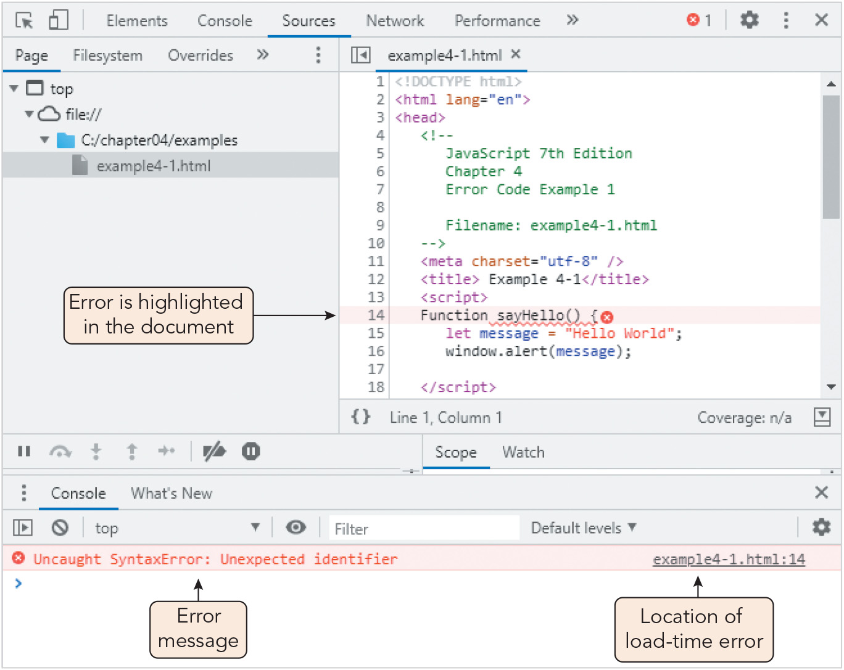
Introduction to Debugging (2 of 6)
Figure 4-1 Load-time error viewed in the Chrome browser console

Slide 5
Introduction to Debugging (3 of 6)
Runtime errors
Runtime errors occur when the interpreter is unable to run the code
Typical causes: attempting to reference an undeclared function or variable, using an undefined value in an expression, illegal mathematical operations
Sample runtime errors (referencing variables outside their scope): function defineVariables() { let pct = 25; // percent value let amt = 1600; // amount value } function calculatePercent() { let result = amt * pct/100; document.write("<p>" + pct + "% of " + amt + " is: "); document.write(result + "</p>"); } defineVariables(); calculatePercent();

Slide 6
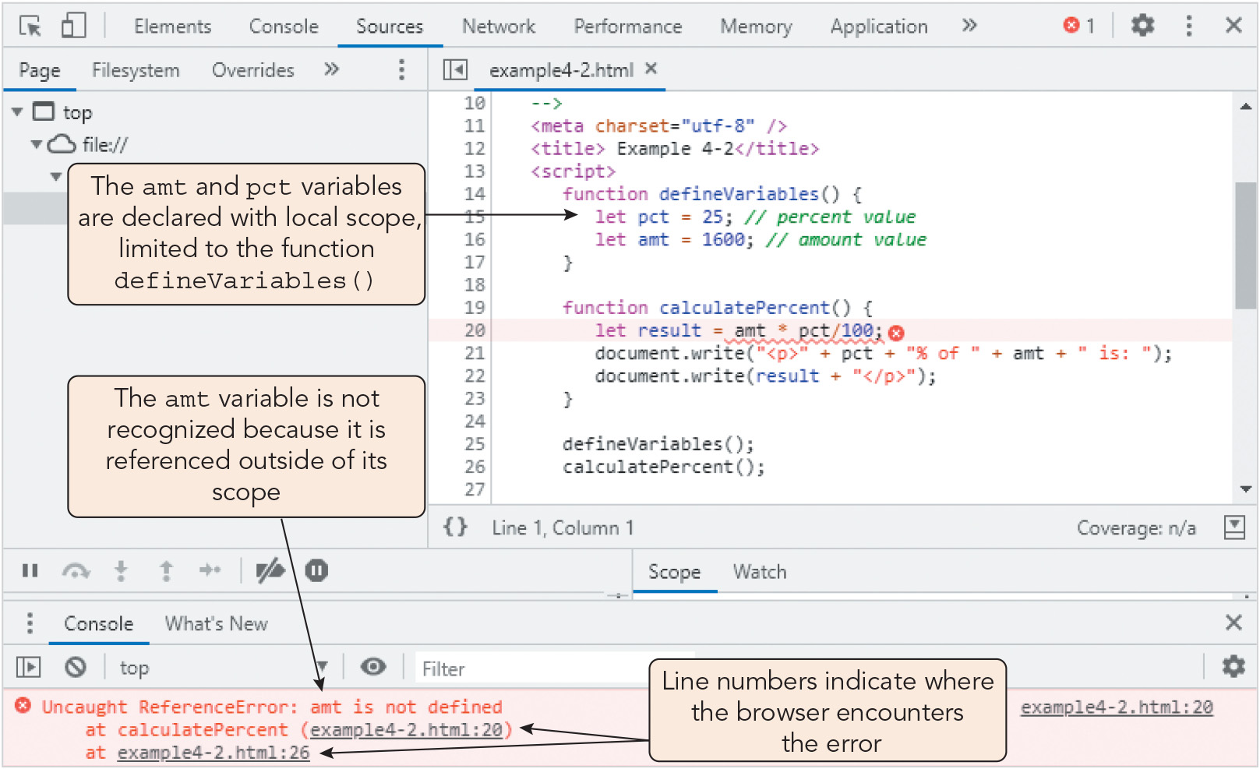
Introduction to Debugging (4 of 6)
Figure 4-2 Runtime error viewed in the Chrome browser console

Slide 7
Introduction to Debugging (5 of 6)
Logic errors
A logic error is a flaw in a program's design that prevents the program from reaching its intended goal
The syntax and statements are correct in themselves but the result is wrong
Sample logic errors (only 2/3 of outcomes are correctly handled): function compareValues(a, b) { if (a > b) { window.alert(a + " is greater than " + b); } else { window.alert(a + " is less than " + b); } }
Linting: sending code through a third-party program that analyzes it and produces a detailed error report

Slide 8
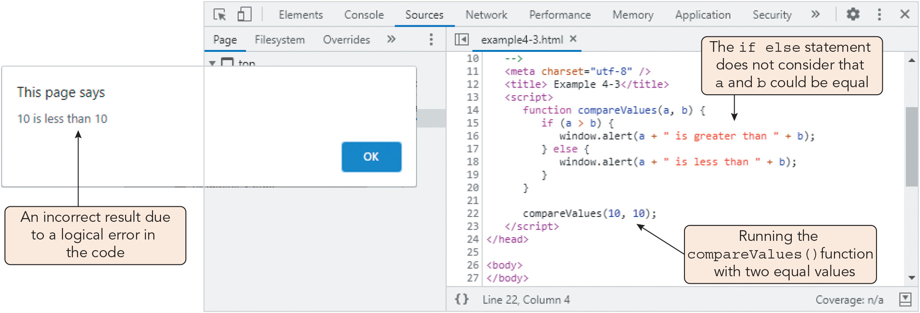
Introduction to Debugging (6 of 6)
Figure 4-3 Logic error viewed in the Chrome browser console

Slide 9
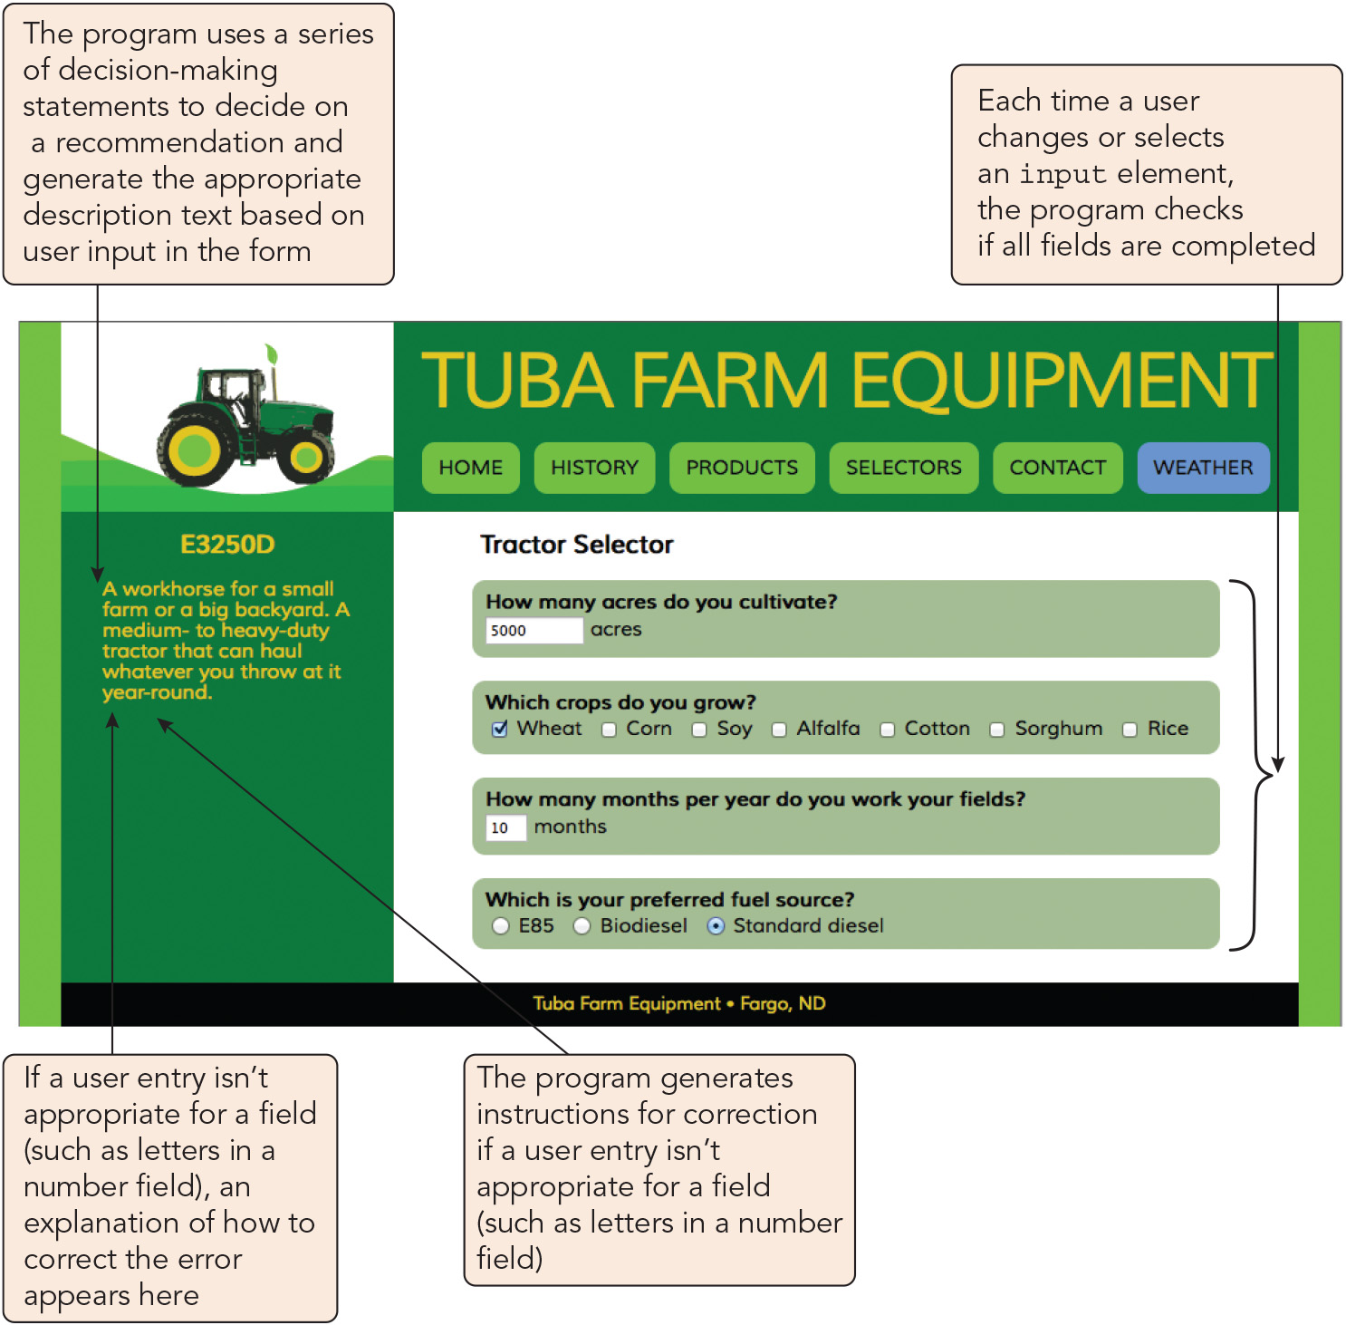
Starting Debugging with the Browser Console (1 of 5)
Figure 4-4 Tuba Farm Equipment page

Slide 10
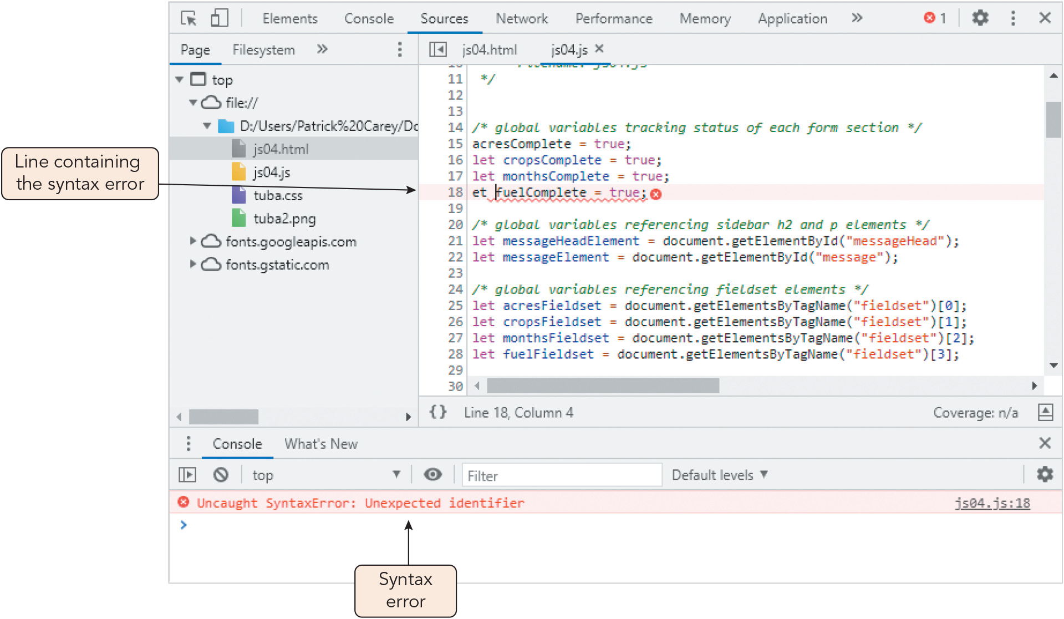
Starting Debugging with the Browser Console (2 of 5)
Figure 4-5 Syntax error in the js04.js file

Slide 11
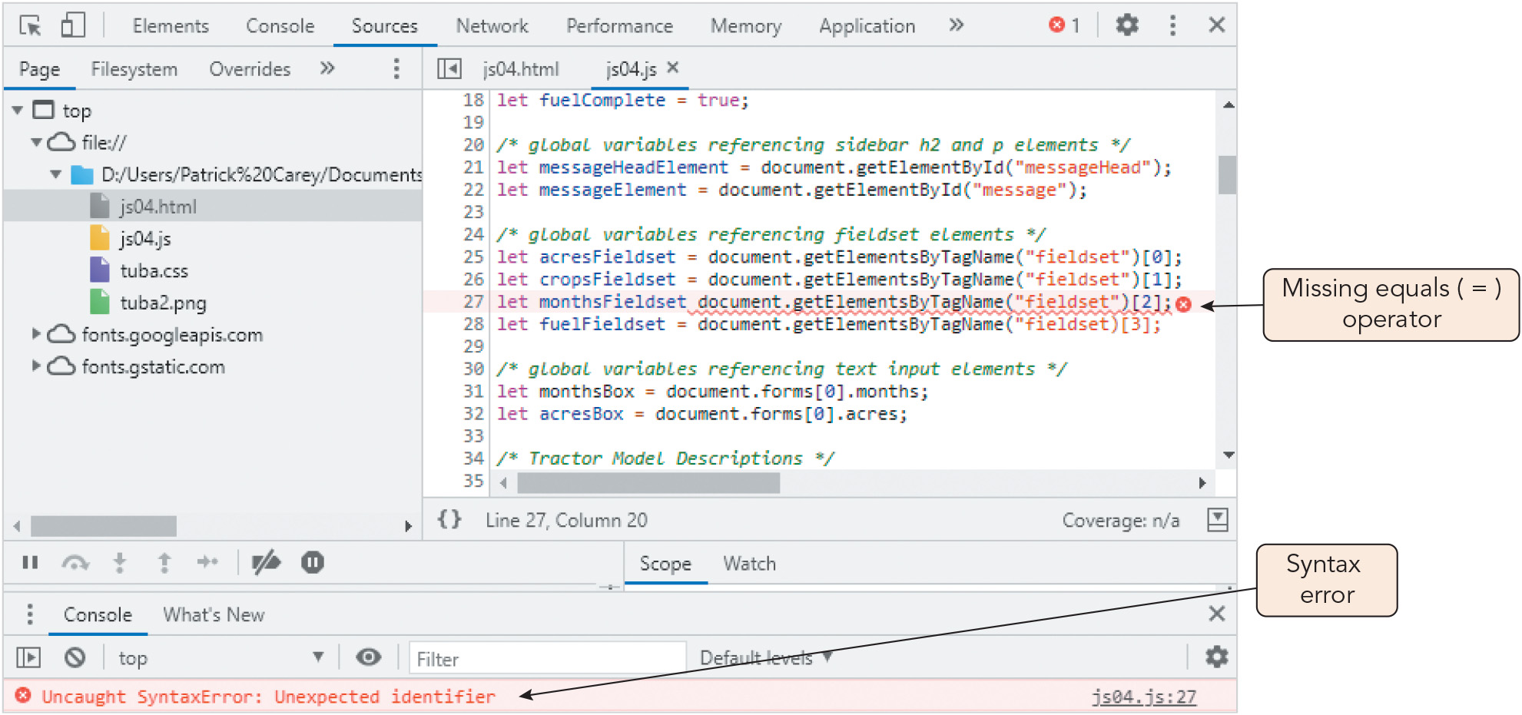
Starting Debugging with the Browser Console (3 of 5)
Figure 4-6 Syntax error declaring a variable

Slide 12
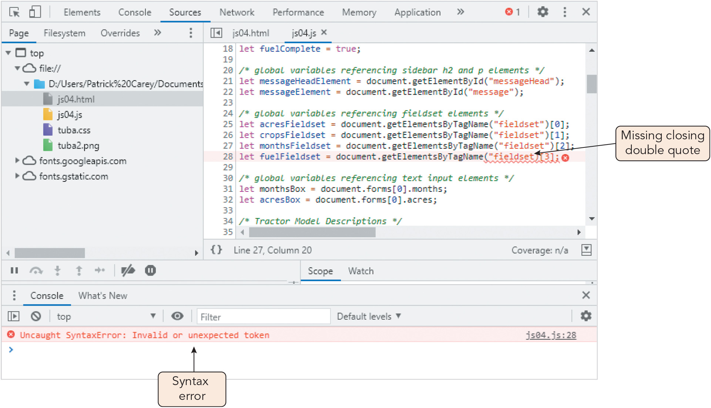
Starting Debugging with the Browser Console (4 of 5)
Figure 4-7 Syntax error with the getElementBy TagName() method

Slide 13
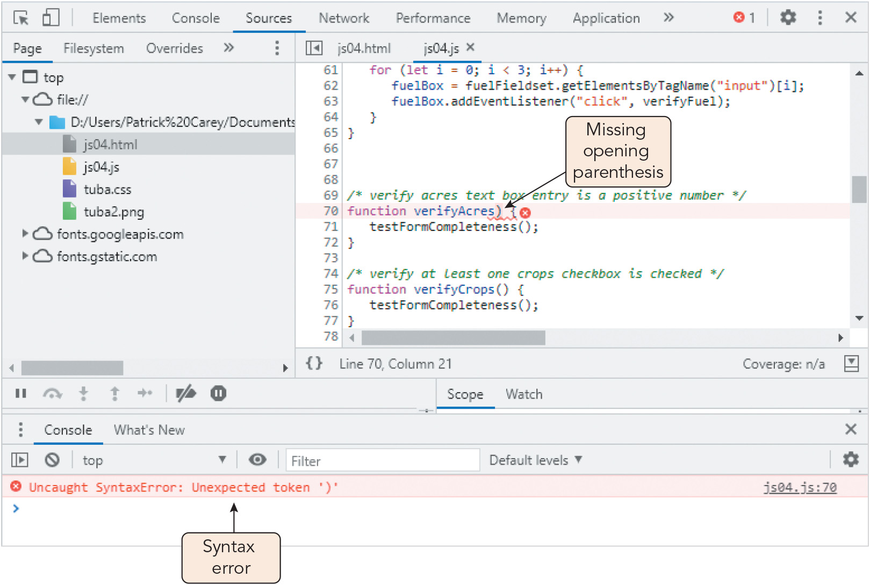
Starting Debugging with the Browser Console (5 of 5)
Figure 4-8 Syntax error declaring a function

Slide 14
Running JavaScript in Strict Mode (1 of 2)
JavaScript interpreters are very forgiving of lapses in syntax and structure
JavaScript's strict mode enforces strict adherence to syntax (marks lapses as errors)
Run a program in strict mode by adding "use strict"; to the beginning of the code
Common error messages:
Uncaught TypeError: cannot read properly
TypeError: 'undefined' is not an object
TypeError: null is not an object
TypeError: object doesn't support property
Uncaught TypeError: cannot set property
ReferenceError: object is not defined

Slide 15
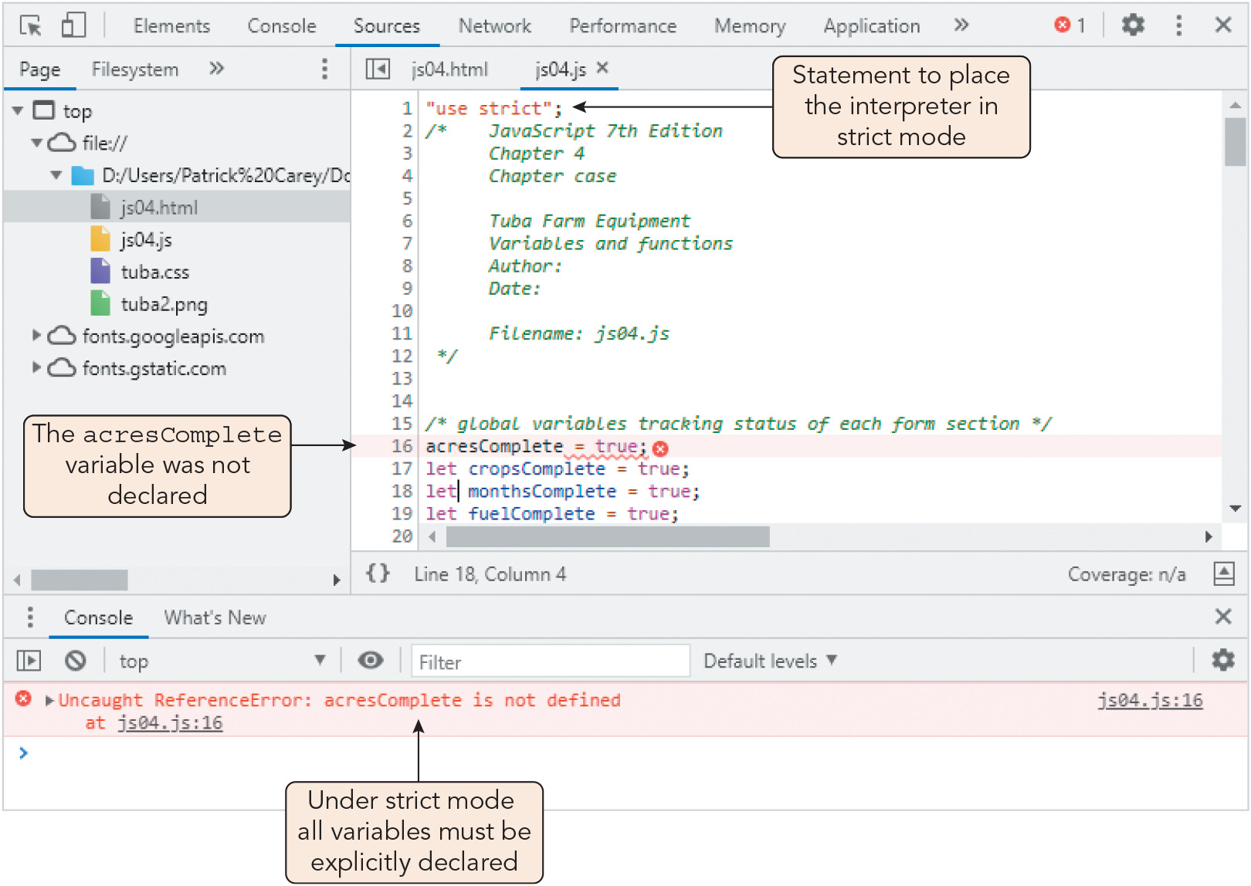
Running JavaScript in Strict Mode (2 of 2)
Figure 4-9 Syntax error under strict mode

Slide 16
Tracing Errors to Their Source (1 of 10)
Tracing errors with the window.alert() method
Tracing: the examination of individual statements in an executing program
Displaying alert boxes at different points in a program to show partial results of a function is one method of tracing logic errors
Statements used to trace code should be placed at a different level of indentation to make them easier to find and remove after debugging
Limitations of this method:
Alert boxes interfere with normal operation and must be deleted after debugging
Alert boxes perform poorly in tracing a long sequence of operations
You cannot compare the contents of alert boxes since only one is visible at a time

Slide 17
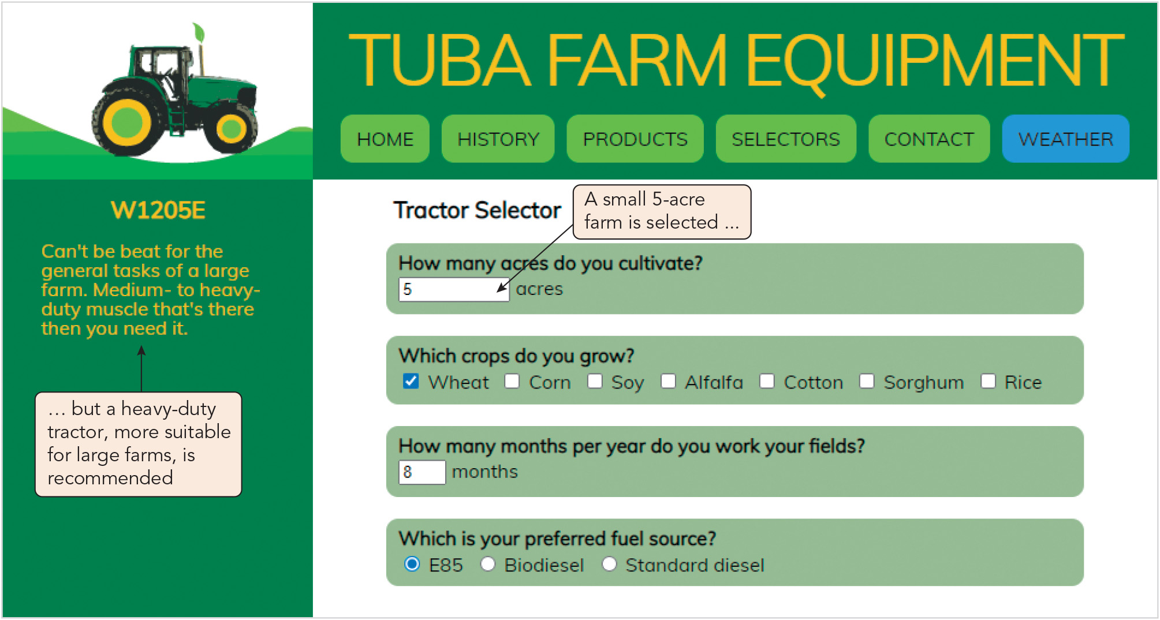
Tracing Errors to Their Source (2 of 10)
Figure 4-11 Logic error in selecting a tractor model

Slide 18
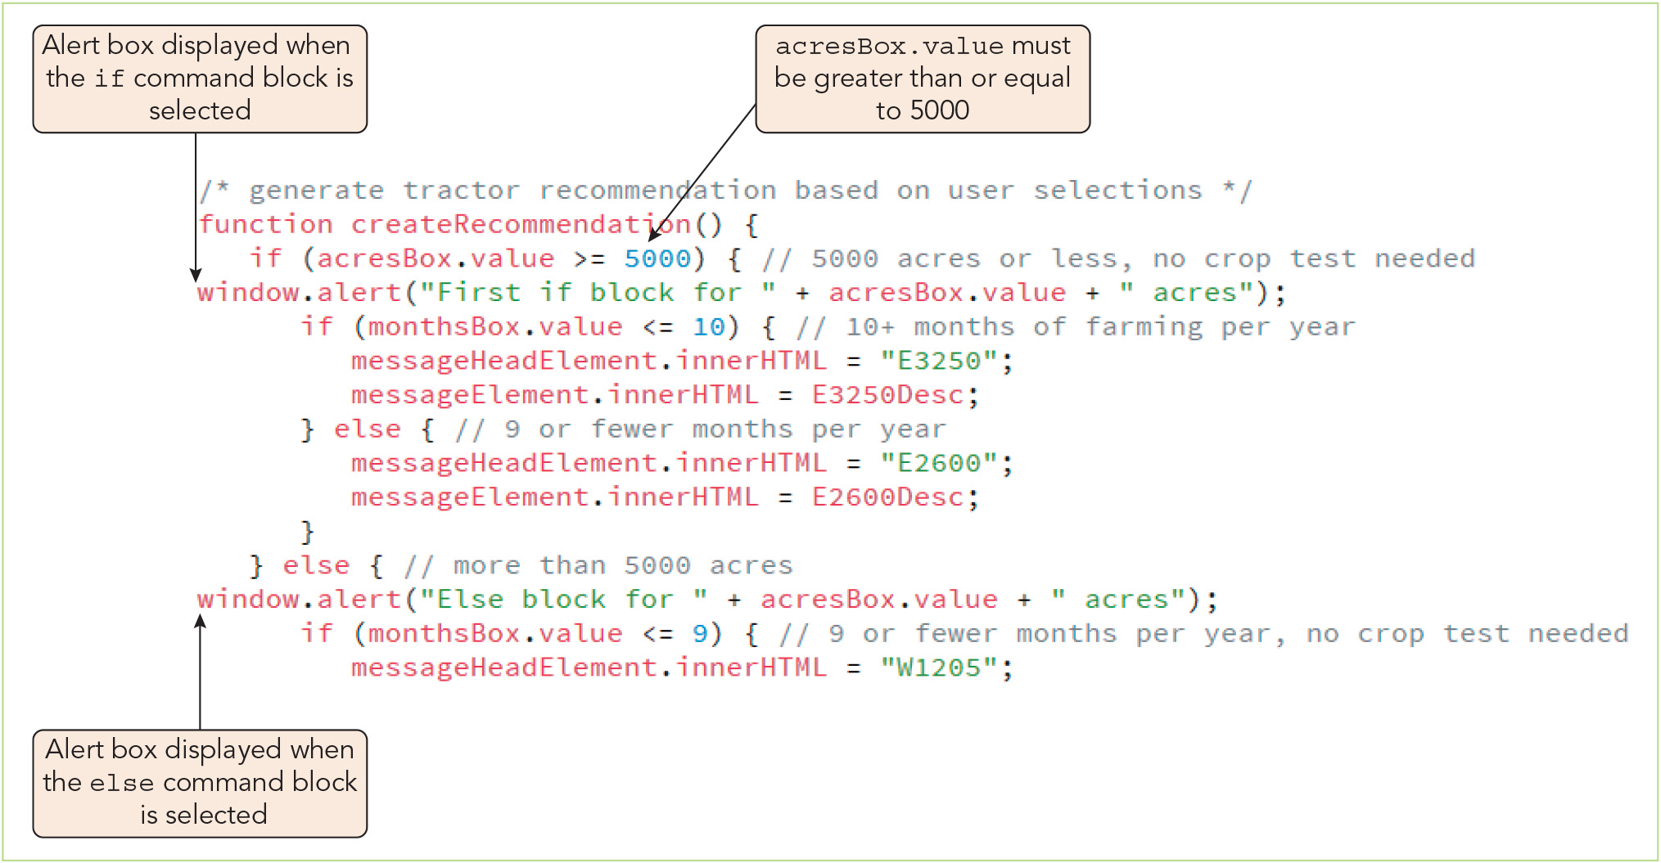
Tracing Errors to Their Source (3 of 10)
Figure 4-12 Tracing a logic error with alert boxes

Slide 19
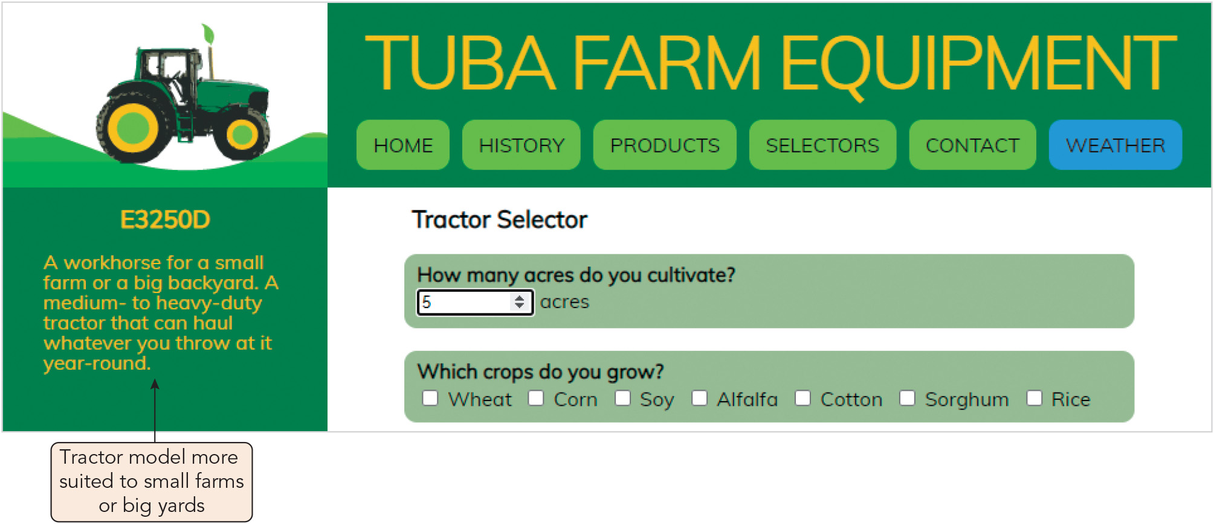
Tracing Errors to Their Source (4 of 10)
Figure 4-13 Selecting a tractor model for a small farm

Slide 20
Tracing Errors to Their Source (5 of 10)
Tracing errors with the console log
Logging (writing) the changing values used in a program in the console log as the program runs is a second tracing strategy
Method, where text is a string that will be written to the console: console.log(text)
Advantages over window.alert() method:
Does not impede program operation (though it might slow it in some cases)
Progression of values is retained in the log for easy viewing/comparison
Console links to the location of each console.log method
Sometimes used in a driver program, a simplified, temporary program used to for testing functions and other code in isolation

Slide 21
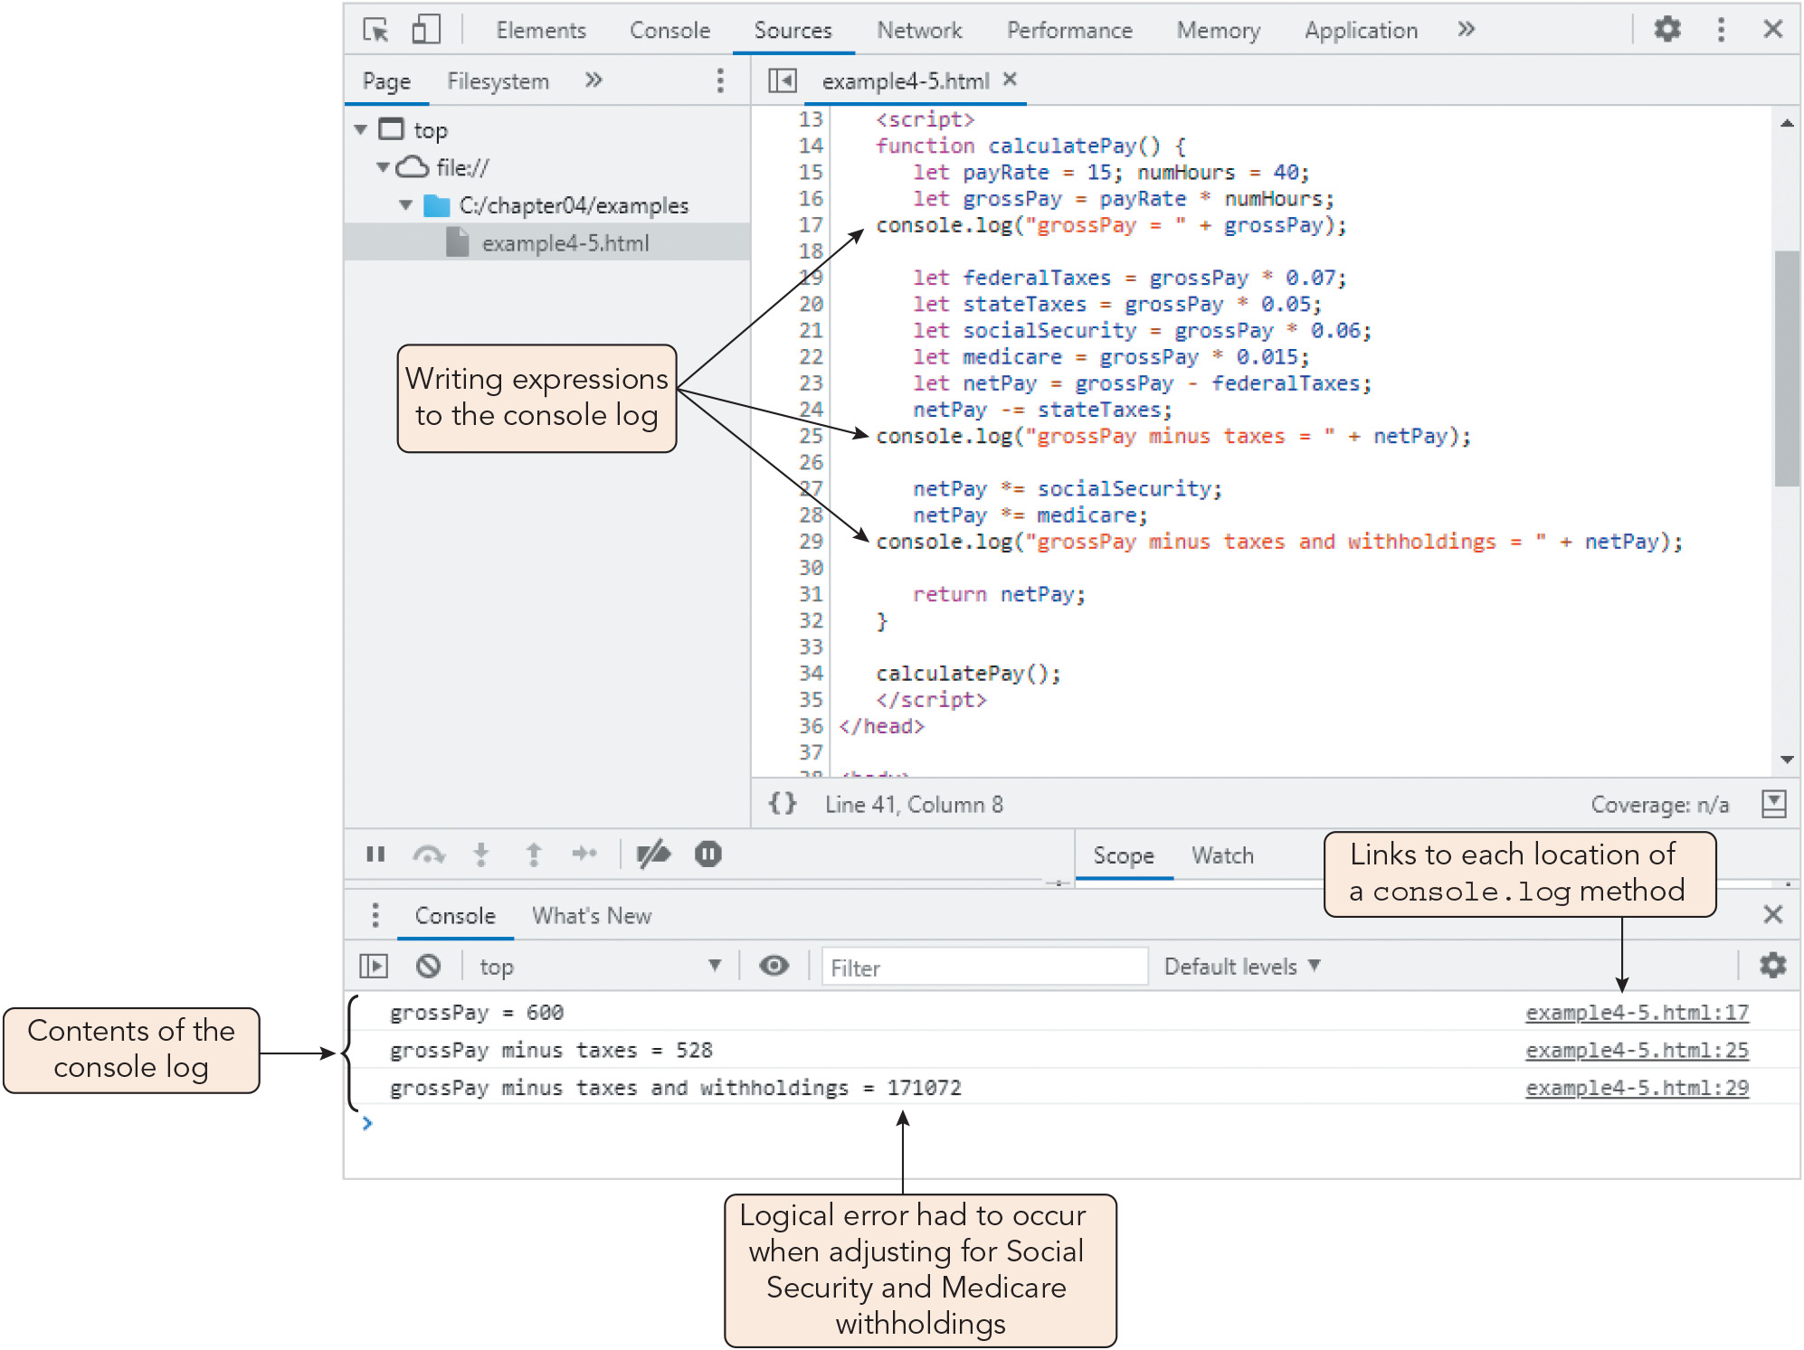
Tracing Errors to Their Source (6 of 10)
Figure 4-14 Using the console log to trace program values

Slide 22
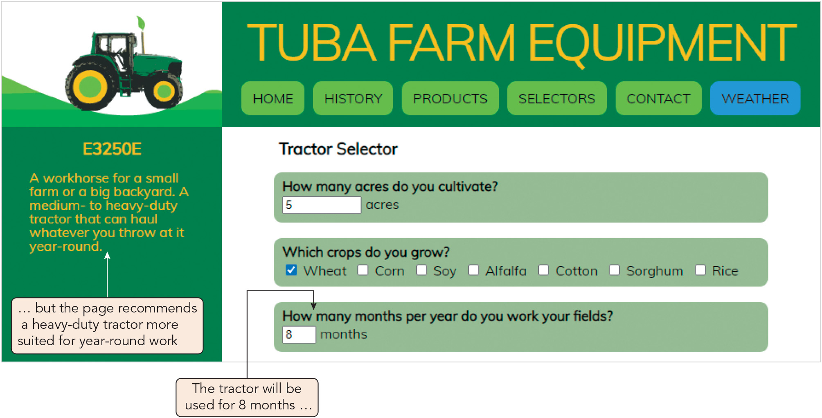
Tracing Errors to Their Source (7 of 10)
Figure 4-15 Logic error in selecting a tractor model for the number of months

Slide 23
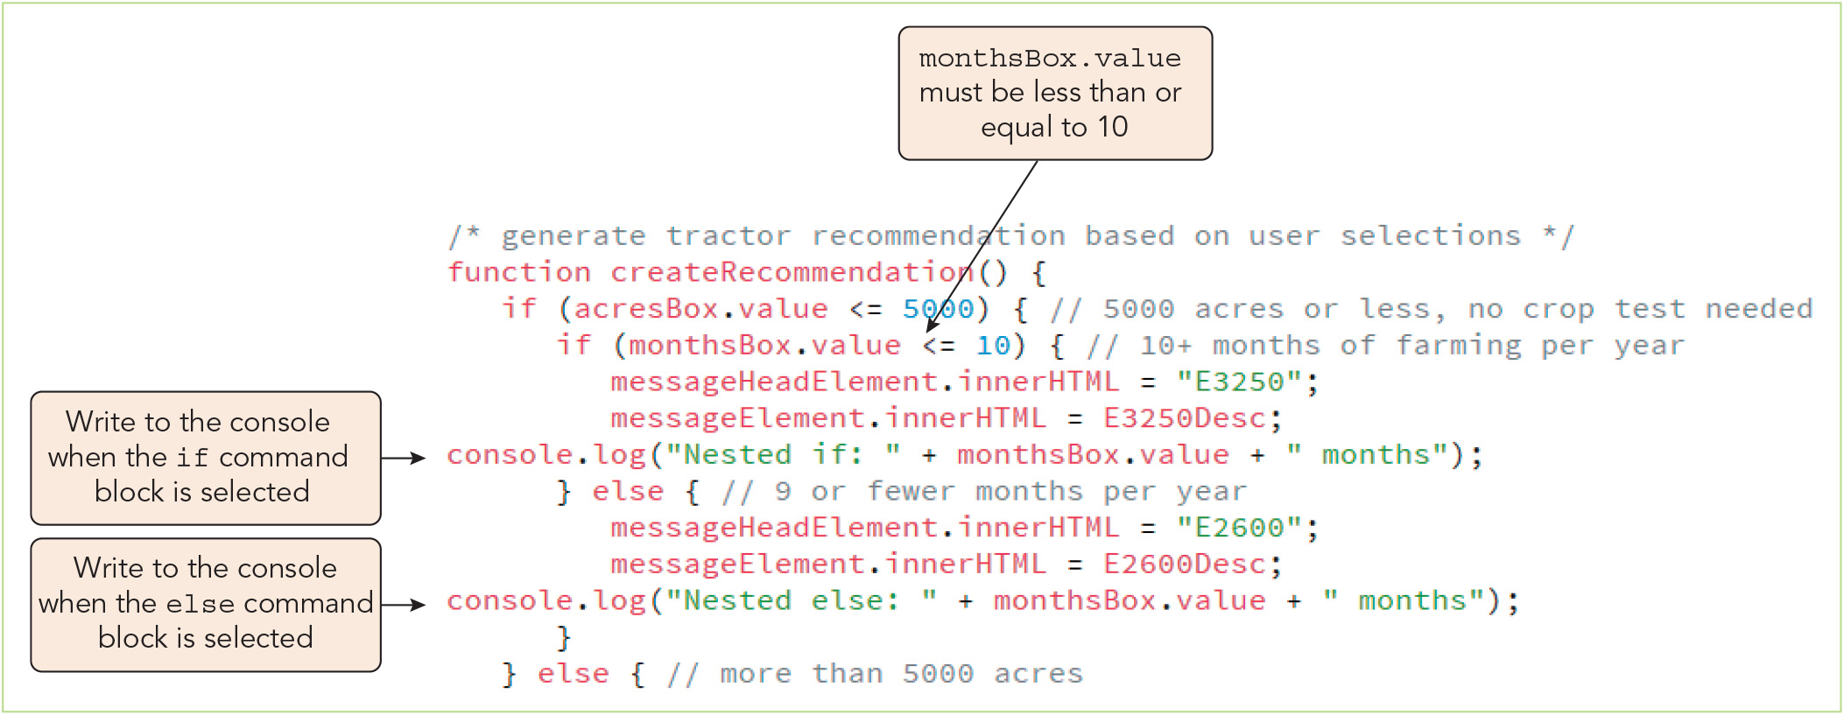
Tracing Errors to Their Source (8 of 10)
Figure 4-16 Tracing a logic error with the console log

Slide 24
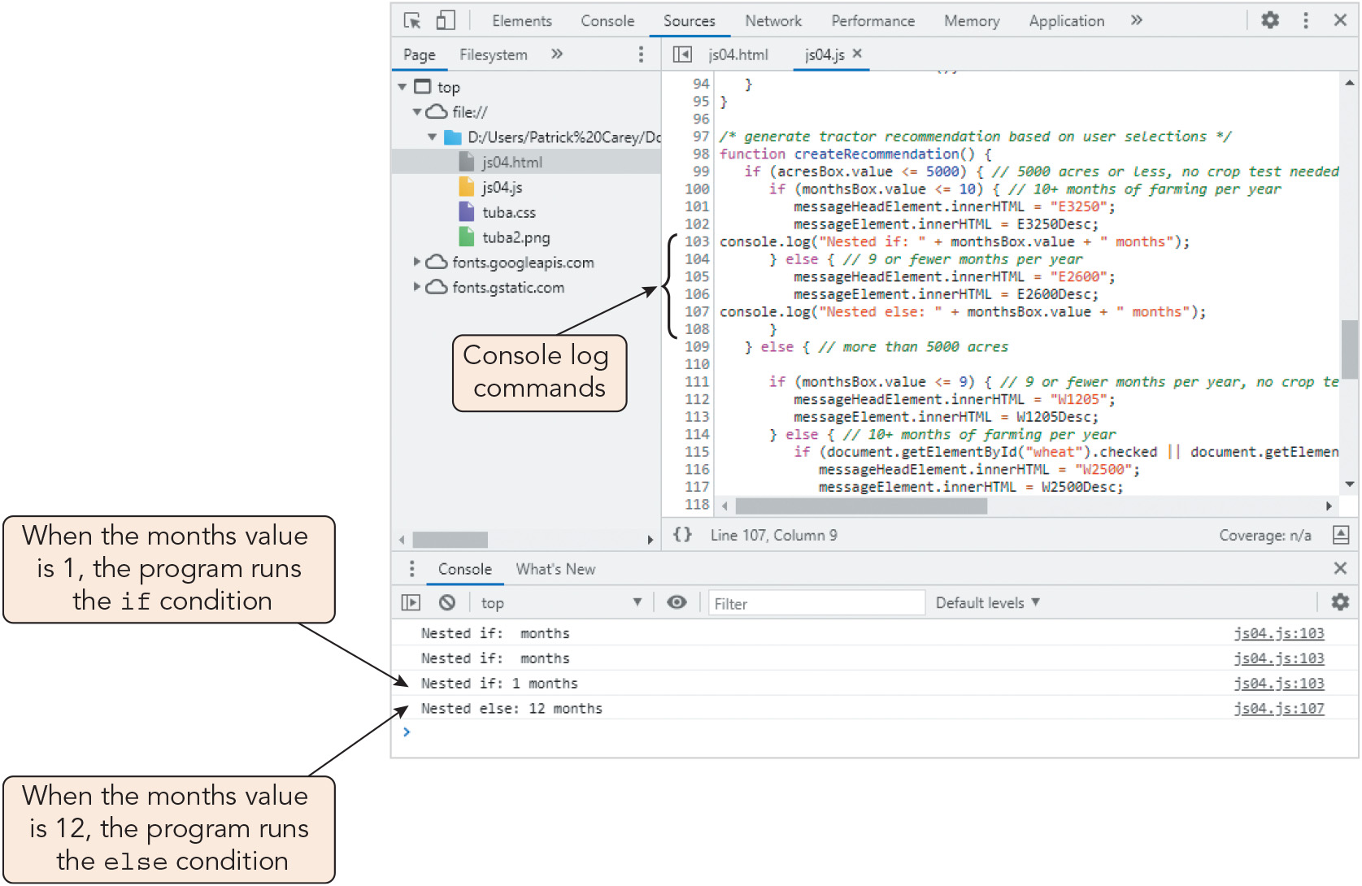
Tracing Errors to Their Source (9 of 10)
Figure 4-17 Console log entries

Slide 25
Tracing Errors to Their Source (10 of 10)
Using comments to locate bugs
Commenting out code: identifying lines that may be causing problems and transforming them into comments by adding // to the start of each line or enclosing a block of statements within the /* and */ characters
If the code runs successfully after the lines are commented out, this indicates the problem lies within that section
Dependencies add an extra layer of complexity to debugging
Dependencies: relationships among statements and the other statements or functions whose successful execution they depend upon
Errors may propagate
Fixing one error may expose or create others, so related functionality must be retested after debugging

Slide 26
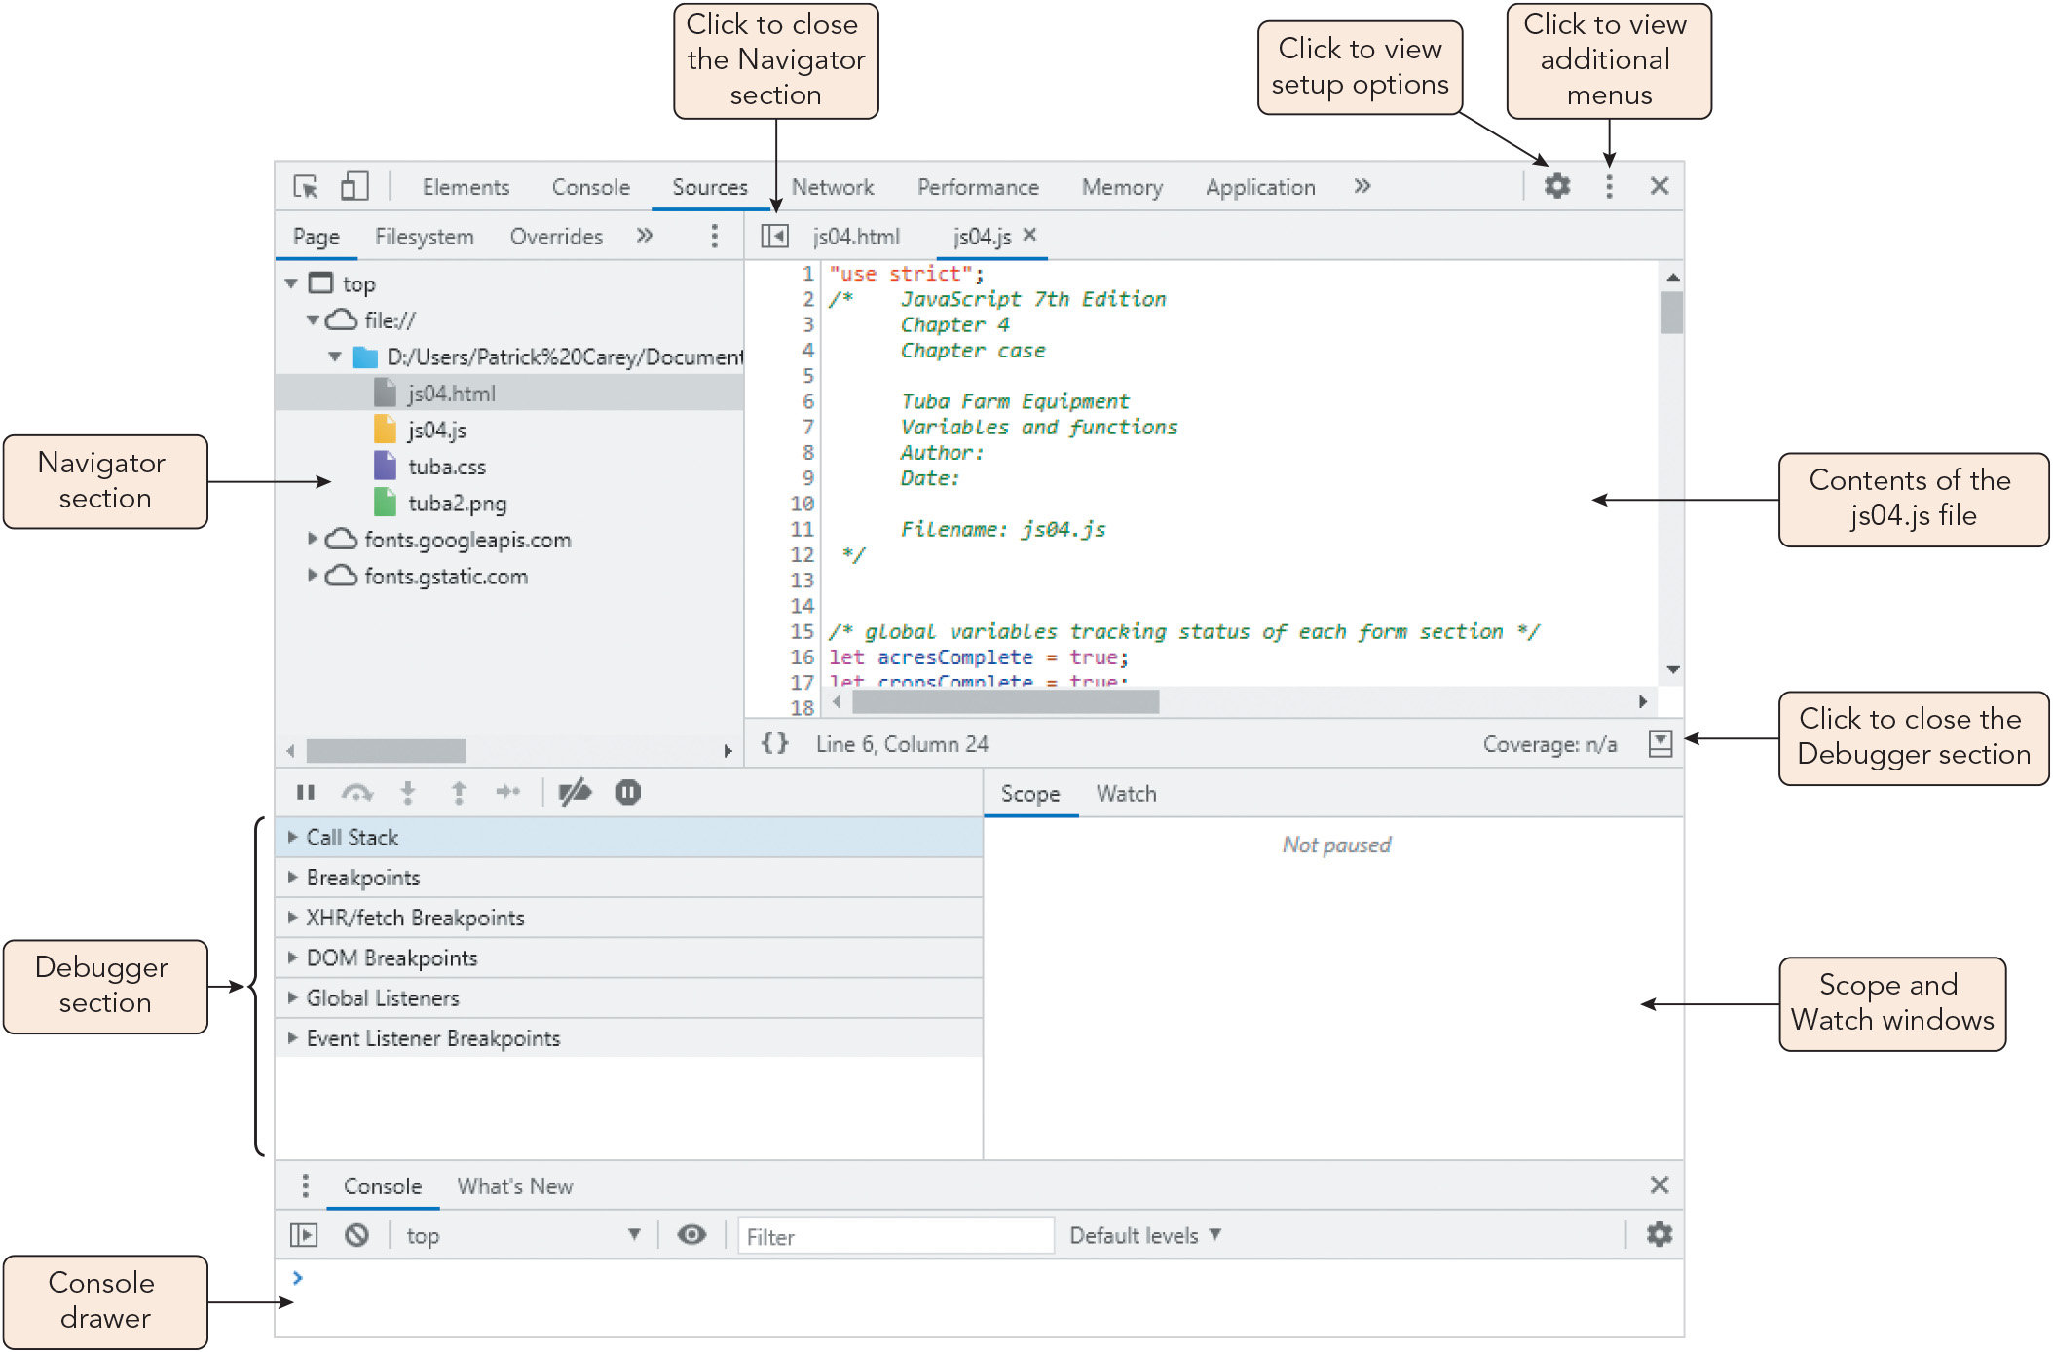
Tracking Program Flow with Debugging Tools (1 of 11)
Figure 4-19 Developer pane in Google Chrome

Slide 27
Tracking Program Flow with Debugging Tools (2 of 11)
Adding and removing break points
Break mode: mode for running a program in which execution is suspended to allow the programmer to review the current state of variables and functions
Breakpoints selected by the programmer mark locations where execution is suspended
Breakpoints are typically added or removed by clicking line numbers
Event listener breakpoints are activated when an event occurs within the web page or browser, and are enabled with a dialog box

Slide 28
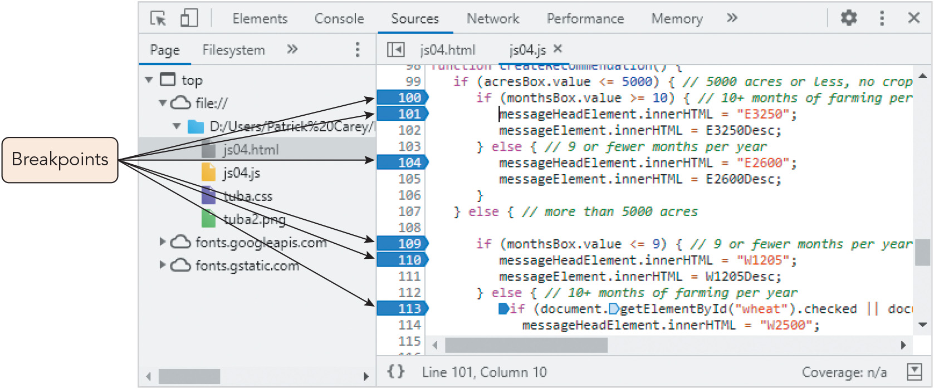
Tracking Program Flow with Debugging Tools (3 of 11)
Figure 4-20 Adding breakpoints to the debugger

Slide 29
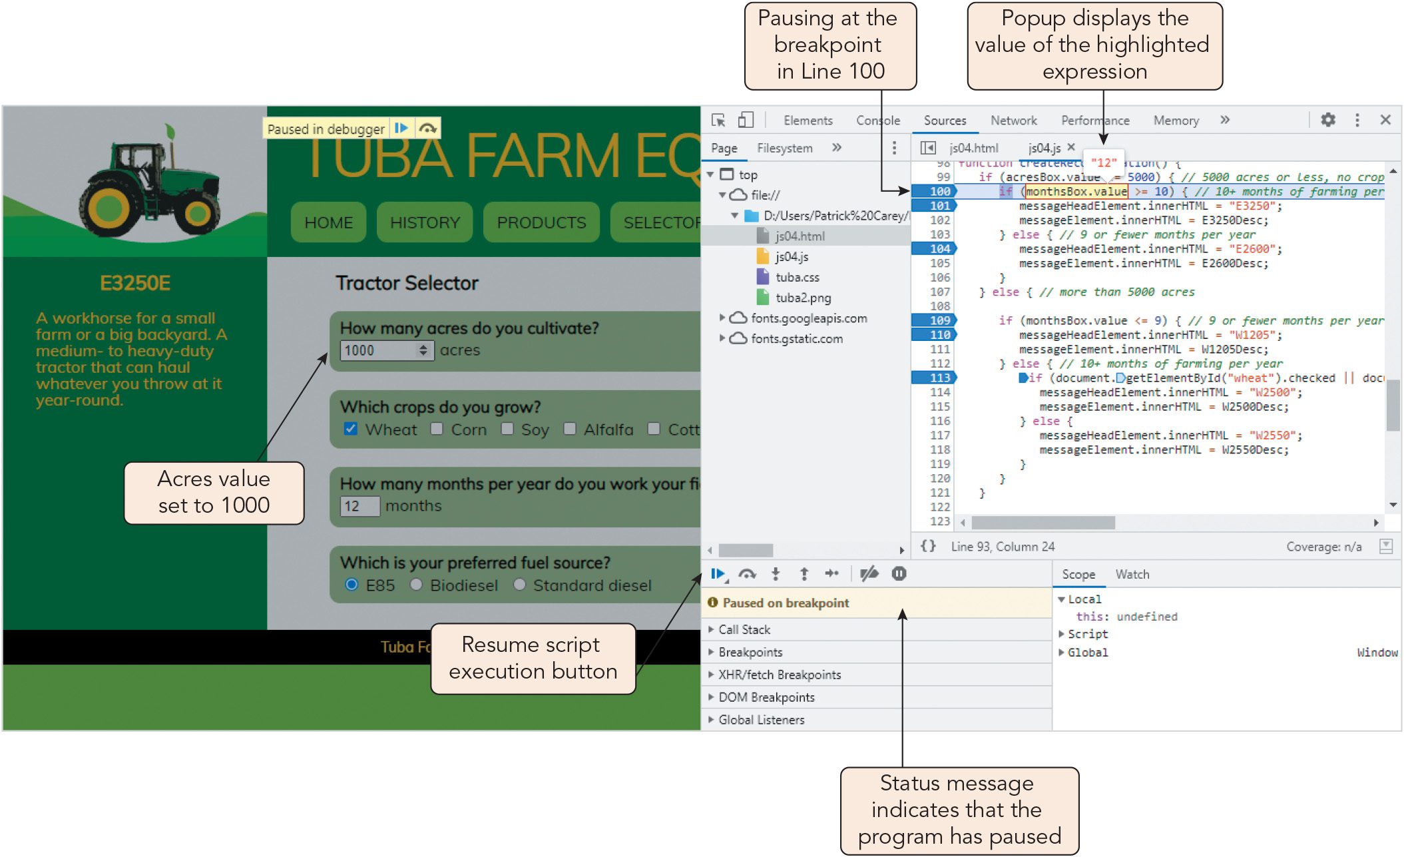
Tracking Program Flow with Debugging Tools (4 of 11)
Figure 4-21 Pausing at a breakpoint

Slide 30
Tracking Program Flow with Debugging Tools (5 of 11)
Stepping through the program execution
Debuggers provide stepping options that control how you step through the code
When you step in (step into) the code, any function called by the program is traced by the debugger one step at a time
You can step over functions you don't need to evaluate in detail
You can step out of the code to execute the remainder without pause
You can insert breakpoints directly into a program by adding the statement debugger;

Slide 31
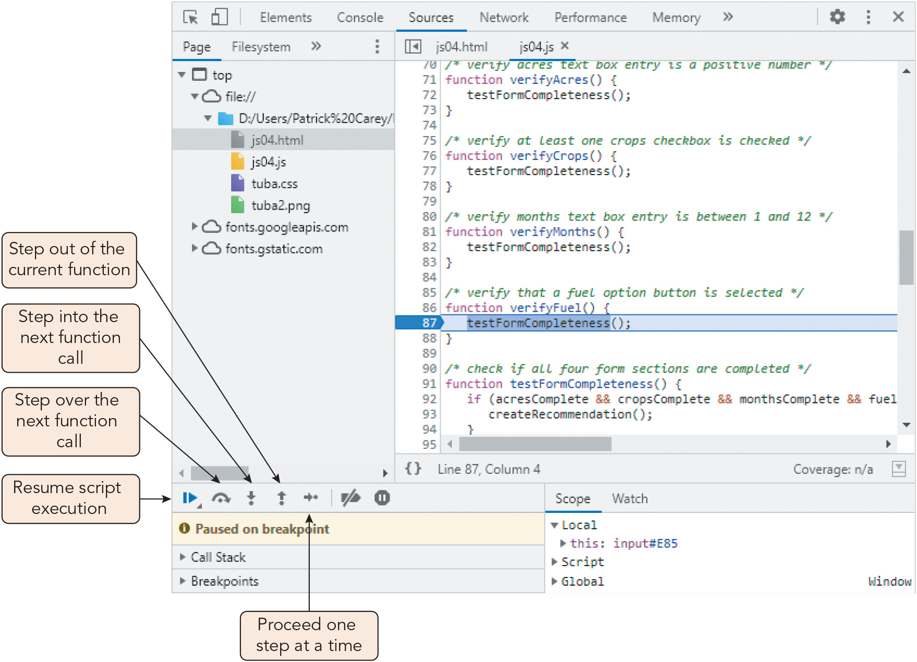
Tracking Program Flow with Debugging Tools (6 of 11)
Figure 4-22 Stepping into a function

Slide 32
Tracking Program Flow with Debugging Tools (7 of 11)
Tracking variables and expressions
The debugger's Scope window lists all the local and global variables and objects available to the program and their current values
List updates as the program executes
Alternatively, you can add a variable or expression you wish to track to the Watch window

Slide 33
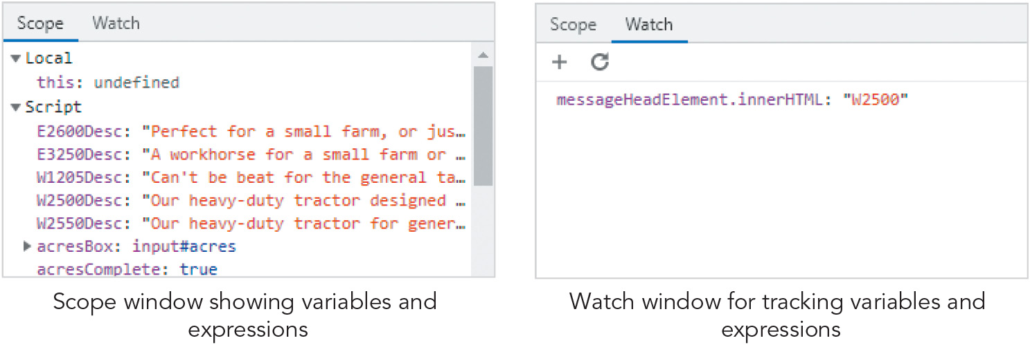
Tracking Program Flow with Debugging Tools (8 of 11)
Figure 4-23 The Scope and Watch windows

Slide 34
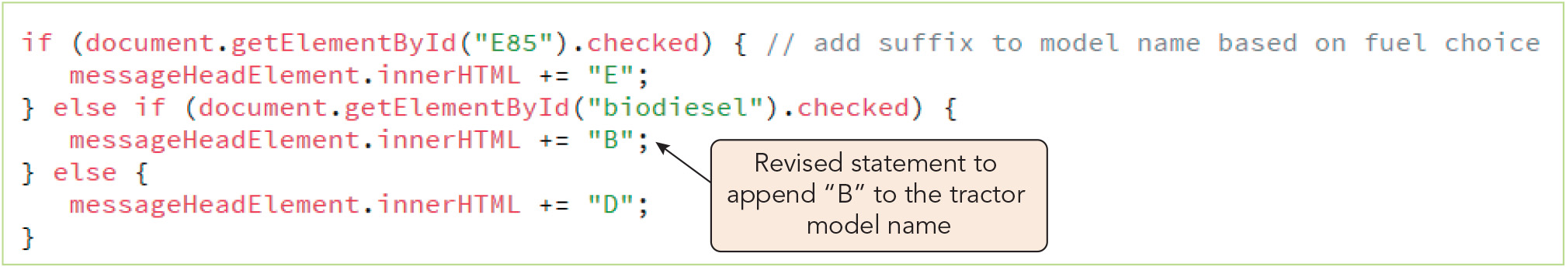
Tracking Program Flow with Debugging Tools (9 of 11)
Figure 4-24 Fixing a logical error

Slide 35
Tracking Program Flow with Debugging Tools (10 of 11)
Examining the call stack
Debugger's call stack lists the functions currently running, displayed in a hierarchical list of function names and properties
Each function or procedure the program calls is added to the top of the call stack
Helpful when tracing code involving multiple functions that call other functions
Can be used to trace the changing values of a variable that is passed as an argument among several functions

Slide 36
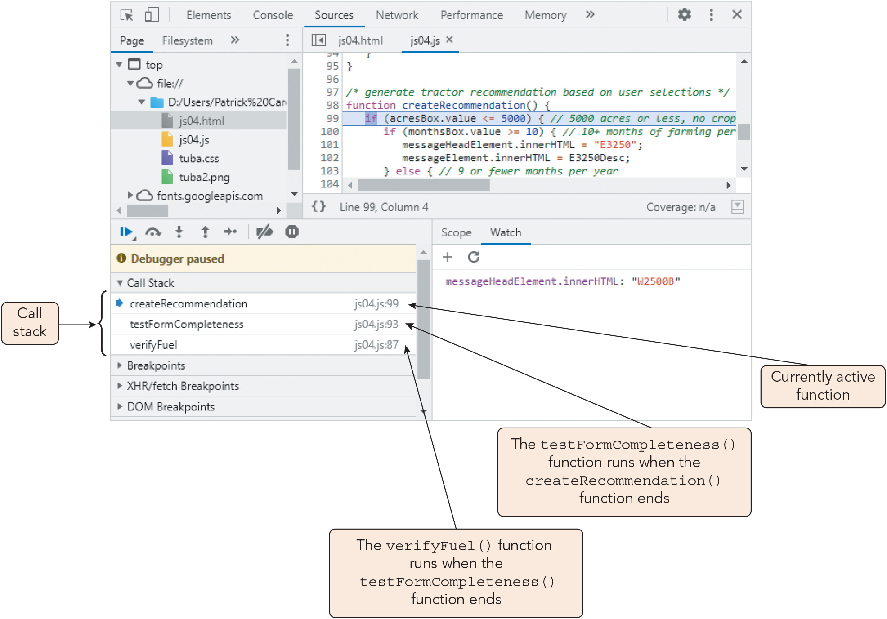
Tracking Program Flow with Debugging Tools (11 of 11)
Figure 4-25 Viewing the call stack

Slide 37
Managing Errors (1 of 10)
User error: an error that occurs when the user mistakenly runs the program in a way not intended by the developer
Bulletproofing: the process of anticipating and handling potential user errors before they cause major problems in the code
Exception handling: a technique whereby the program handles errors rather than leaving that task to the JavaScript interpreter
Handling exceptions with the try catch statement
Statements that might contain an error can be tested within the try command block
If an error is present, the catch command block is run, overriding the browser's default error handling
If no errors are present, the program execution moves to the next statement

Slide 38
Managing Errors (2 of 10)
Handling exceptions with the try catch statement (continued)
Syntax, where error is an error object that contains information about the error: try { statements that might contain an error; } catch (error) { statements that respond to the error }
Sample try catch statement: let userName = "Jenkins"; try { window.alert("The user is " + username); } catch(err) { window.alert("Invalid code"); }

Slide 39
Managing Errors (3 of 10)
Throwing an exception
The code can throw an exception (a programmer-defined error) in response to user errors not recognized by the JavaScript interpreter
Syntax: throw id, where id is a value or text string that identifies the error
Sample exception to prevent calculating the square root of a negative number: if (number < 0) throw "Attempt to calculate the square root of a negative value."; let sqrt = number**0.5; window.alert("The square root of " + number is + " is " + sqrt);
Sample try catch statement that throws an exception for a missing input: try { userID = document.getElementById("IDBox").value; if (userID === "") throw "Missing user ID"; window.alert("Your user ID is " + userID); } catch(err) { window.alert("You must enter a user ID"); }

Slide 40
Managing Errors (4 of 10)
The try catch finally statement
A finally clause, which is always executed (whether or not an error is found), can supplement exception handling
Syntax for a try catch finally statement: try { statements that might contain an error; } catch (error) { statements to respond to the error } finally { statements to run with or without an error }

Slide 41
Managing Errors (5 of 10)
The try catch finally statement (continued)
Sample use of try catch finally statement: try { userID = document.getElementById("IDBox").value; if (userID === "") throw "Missing user ID"; window.alert("Your user ID is " + userID); } catch(err) { window.alert("You must enter a user ID"); } finally { window.alert("Thank You"); }
Multiple catch statements can be included to handle multiple exception types
The nearest catch statement to the thrown exception is executed
Every try statement must be followed by a catch or finally statement or both

Slide 42
Managing Errors (6 of 10)
The error parameter in the catch statement
Contains information about the error that was caught
Object for built-in errors has name a property and message property (description)
For custom errors, the id specified in the throw operator serves as the error message
The error parameter is optional in ES10 (2019)

Slide 43
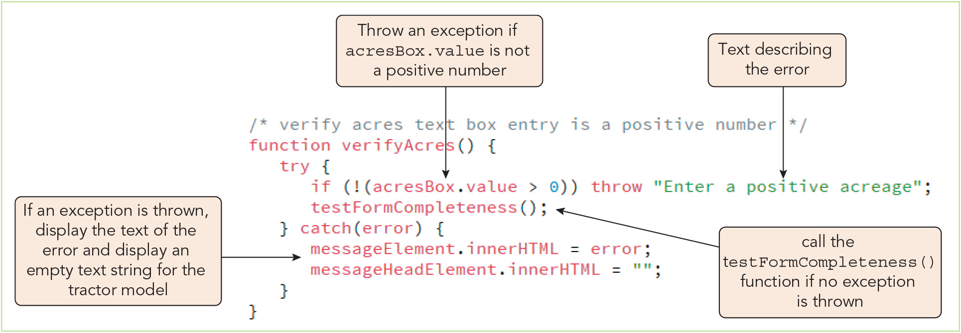
Managing Errors (7 of 10)
Figure 4-26 Creating a try catch statement

Slide 44
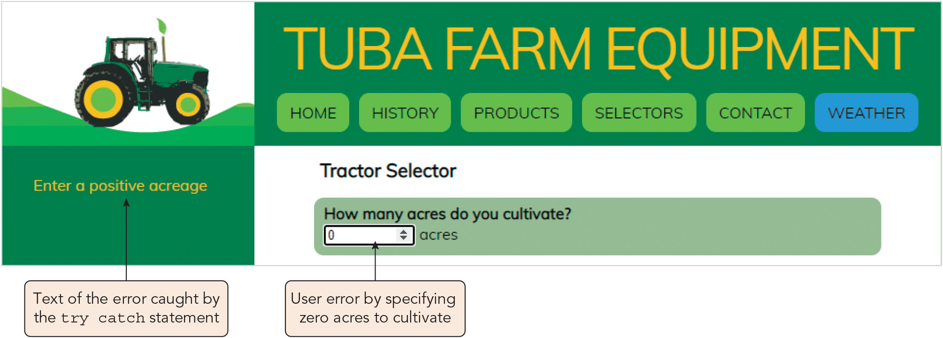
Managing Errors (8 of 10)
Figure 4-27 Catching an invalid acreage

Slide 45
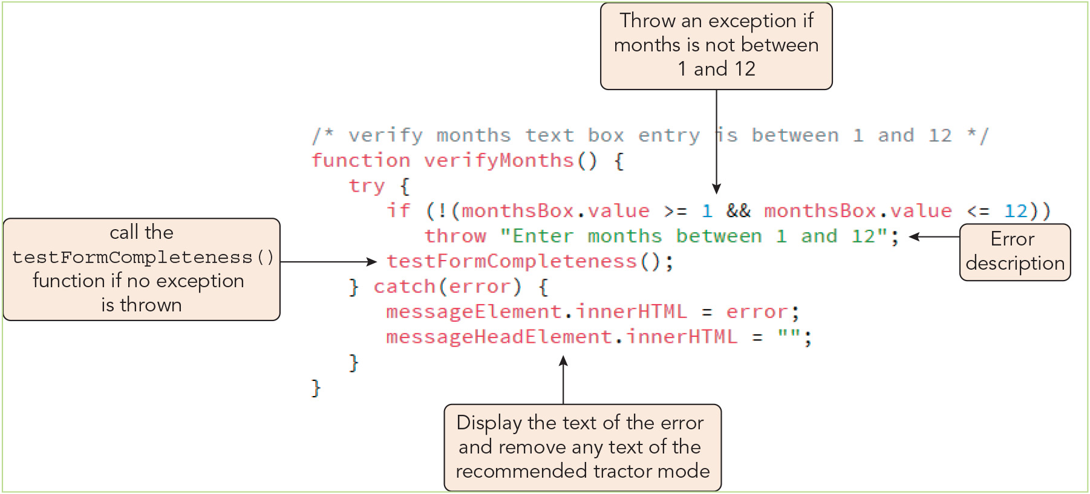
Managing Errors (9 of 10)
Figure 4-28 Testing for invalid months of operation

Slide 46
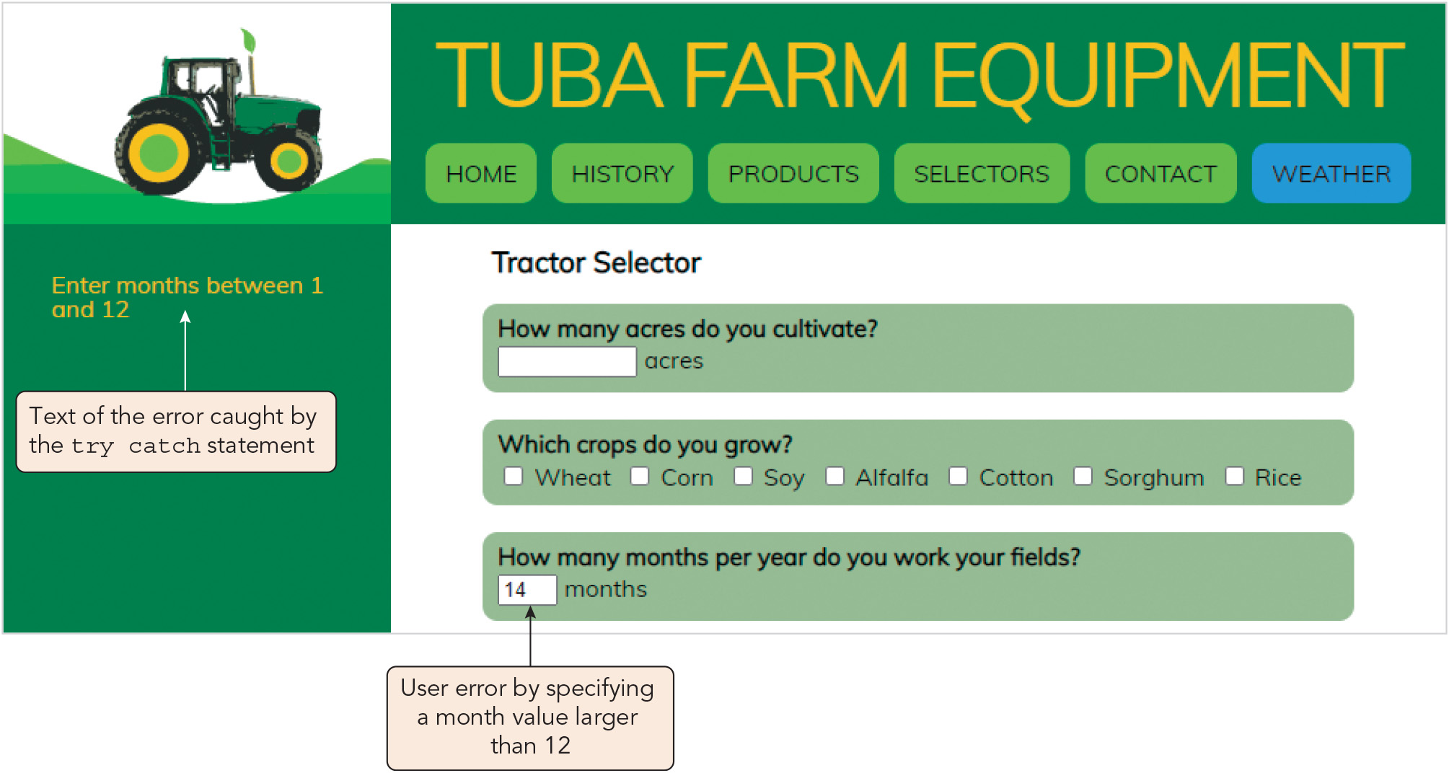
Managing Errors (10 of 10)
Figure 4-29 Catching an invalid duration of operation

Slide 47
Summary
Now that the lesson has ended, you should have learned to:
Understand four different types of errors that programmers must deal with.
Use the debugger console to locate errors in a program.
Use JavaScript in strict mode.
Trace an error to its source.
Track the flow of your program using debugger tools.
Manage errors in your code using a try catch statement.
Control how a browser handles errors.
Notes:
Instructions: Reiterate the learning objectives for the lesson. Students should use this information to guide their studies and reinforcement of new concepts.

